Slide 1

Effect on Water Filtration Time
Unreplicated Fractional Factorial Designs Analysis
MTH 547: DOX
Instructor: Dr. Maher Qumsiyeh
Term: Fall 2021
Student Name: Serge Alhalbi

Slide 2
Outline
INTRODUCTION
ANALYSIS (FOR EACH DESIGN)
Conclusion
DATA SETS
DESIGN DESCRIPTION
MODEL ANALYSIS
ADEQUACY PLOTS
BEST SETTING(S)
DESIGNS COMPARISON

Slide 3
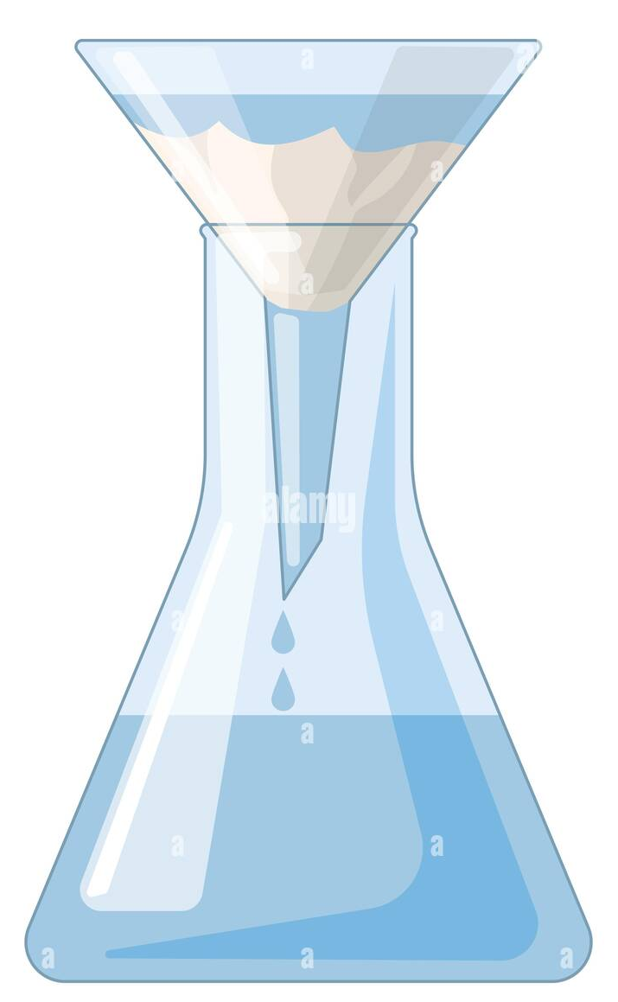
Data sets
y | A | B | C | D | E | F | G
68.4 | -1 | -1 | -1 | 1 | 1 | 1 | -1
77.7 | 1 | -1 | -1 | -1 | -1 | 1 | 1
66.4 | -1 | 1 | -1 | -1 | 1 | -1 | 1
81 | 1 | 1 | -1 | 1 | -1 | -1 | -1
78.6 | -1 | -1 | 1 | 1 | -1 | -1 | 1
41.2 | 1 | -1 | 1 | -1 | 1 | -1 | -1
68.7 | -1 | 1 | 1 | -1 | -1 | 1 | -1
38.7 | 1 | 1 | 1 | 1 | 1 | 1 | 1
Data sets 1 & 2:
Data sets 1 & 2 :
Response y: Water Filtration Time (In Minutes)
Factor A: Water Supply Source (Town & Well)
Factor B: Raw Material Source (On Site & Other)
Factor C: Temperature (Low & High)
y | A | B | C | D | E | F | G
68.4 | -1 | -1 | -1 | 1 | 1 | 1 | -1
77.7 | 1 | -1 | -1 | -1 | -1 | 1 | 1
66.4 | -1 | 1 | -1 | -1 | 1 | -1 | 1
81 | 1 | 1 | -1 | 1 | -1 | -1 | -1
78.6 | -1 | -1 | 1 | 1 | -1 | -1 | 1
41.2 | 1 | -1 | 1 | -1 | 1 | -1 | -1
68.7 | -1 | 1 | 1 | -1 | -1 | 1 | -1
38.7 | 1 | 1 | 1 | 1 | 1 | 1 | 1
66.7 | 1 | 1 | 1 | -1 | -1 | -1 | 1
65 | -1 | 1 | 1 | 1 | 1 | -1 | -1
86.4 | 1 | -1 | 1 | 1 | -1 | 1 | -1
61.9 | -1 | -1 | 1 | -1 | 1 | 1 | 1
47.8 | 1 | 1 | -1 | -1 | 1 | 1 | -1
59 | -1 | 1 | -1 | 1 | -1 | 1 | 1
42.6 | 1 | -1 | -1 | 1 | 1 | -1 | 1
67.6 | -1 | -1 | -1 | -1 | -1 | -1 | -1
Factor D: Recycle (No & Yes)
Factor E: Caustic Soda Addition Rate (Slow & Fast)
Factor F: Filter Cloth Old (Old & New)
Factor G: Holdup Time (Low & High)
8 runs & 16 runs respectively

Slide 4
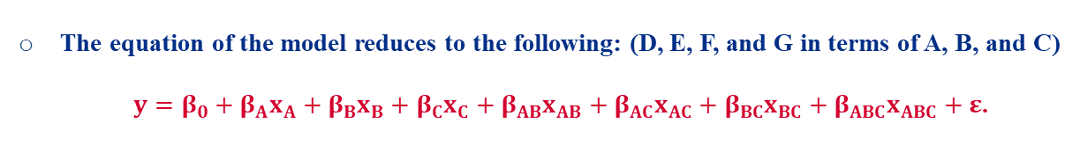
Design I Analysis
Design Description:
It’s an unreplicated 2⁷⁻⁴ FFD design with 7 factors and 8 runs: (2^{k-p}) with k = 7 and p = 4
The design generators are 4 since p = 4: ABD = +I, ACE = +I, BCF = +I, ABCG = +I.
Resolution III: (Maximum Resolution)
The defining relations are 15 since 2^{p} – 1 = 15.
The alias structure consists of 7 relations since 2^{k-p} – 1 = 7.
The equation of the model reduces to the following: (D, E, F, and G in terms of A, B, and C) $y=β_{0}+{β_{A}x}_{A}+{β_{B}x}_{B}+{β_{C}x}_{C}+{β_{AB}x}_{AB}+{β_{AC}x}_{AC}+{β_{BC}x}_{BC}+{β_{ABC}x}_{ABC}+ε$.
Degree of freedom of the error: ${df}_{Error}=0$(Where: ${df}_{Factor/Interaction}=1$)

Slide 5
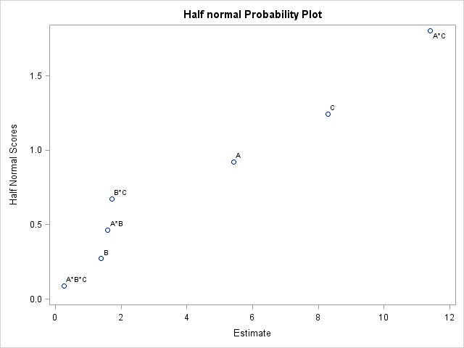
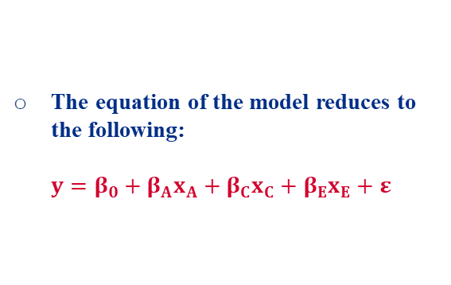
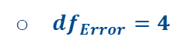
Design I Analysis
Model Analysis:
Half Normal Plot: A, C, and AC should be significant
The equation of the model reduces to the following: $y=β_{0}+{β_{A}x}_{A}+{β_{C}x}_{C}+{β_{E}x}_{E}+ε$
${df}_{Error}=4$
Note: E = AC

Slide 6
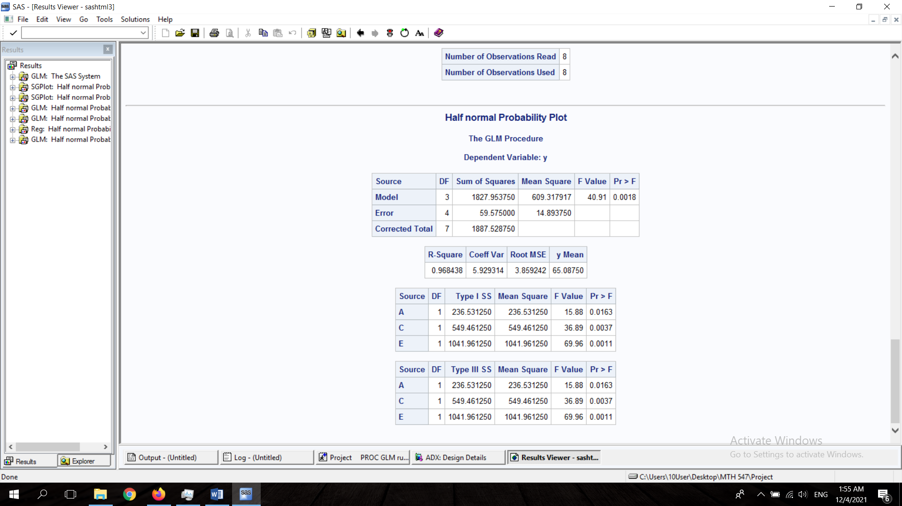
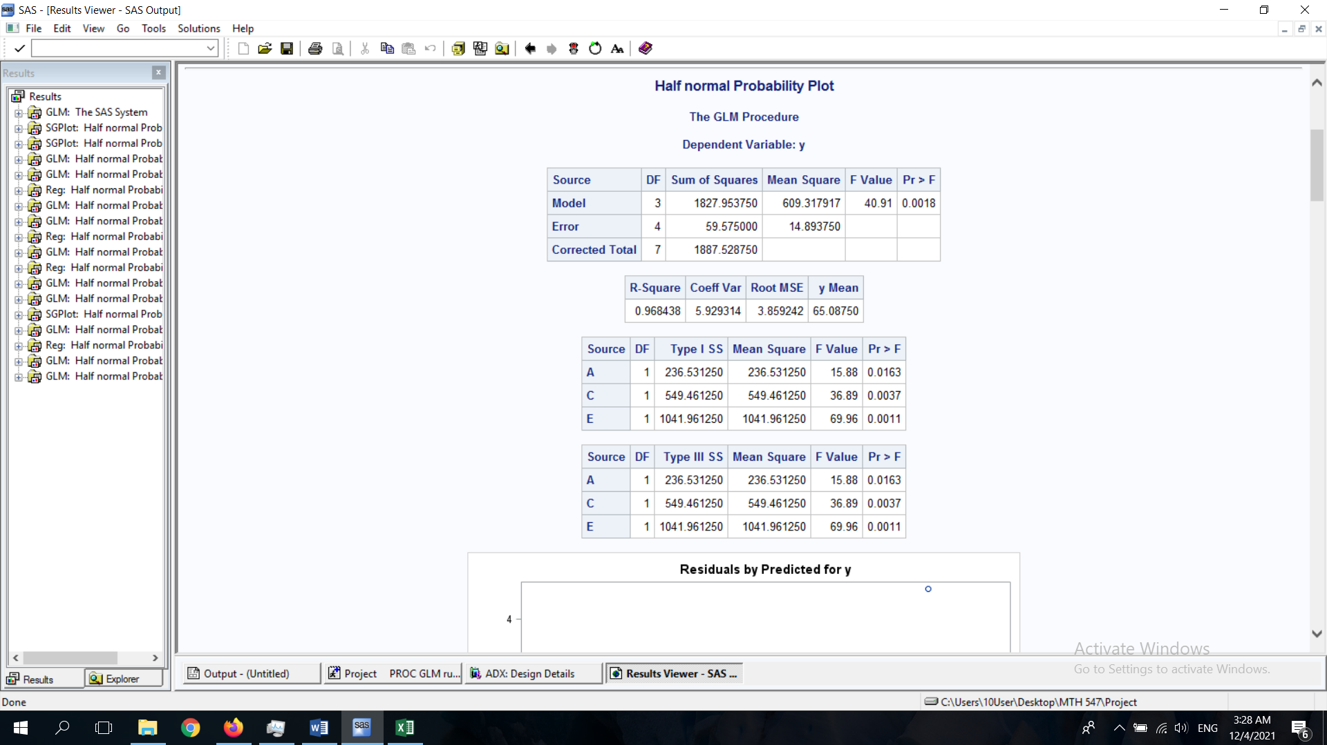

Design I Analysis
Model Analysis:
Testing If The Model Is Fit: Fit ✓
${R_{adj}}^{2}=0.9448$
Testing The Significance of The Parameters: All significant.

Slide 7
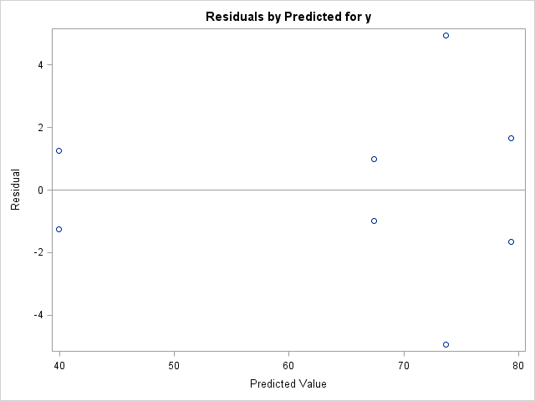
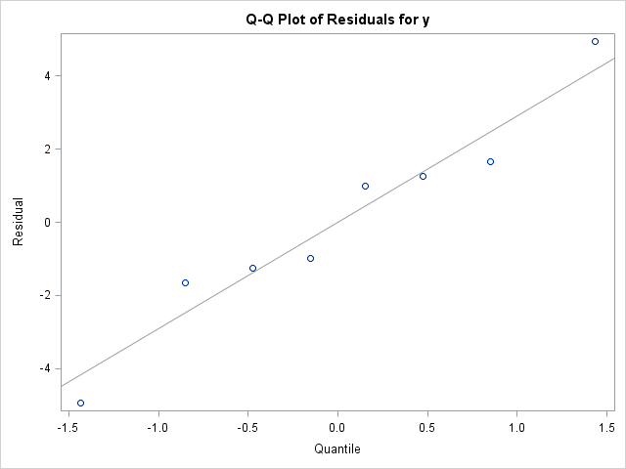
Design I Analysis
Adequacy Plots: (No Transformation Needed)
The Residuals Have Equal Variances
The Residuals seem to be Normally Distributed

Slide 8
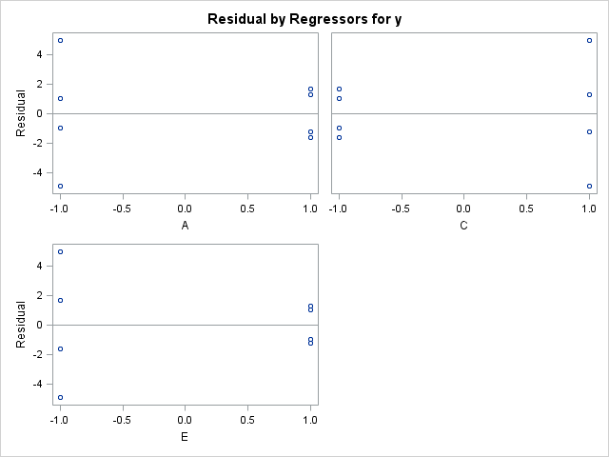
Design I Analysis
Adequacy Plots 2: (No Comment)

Slide 9
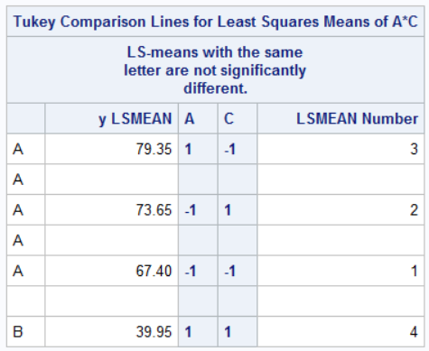
Design I Analysis
Best Setting(s): (Minimum Time)
A = 1 & C = 1 for an average of 39.95 minutes
Or: Water Supply Source: Well & Temperature: High
Note: The p-values assure that this is true.

Slide 10
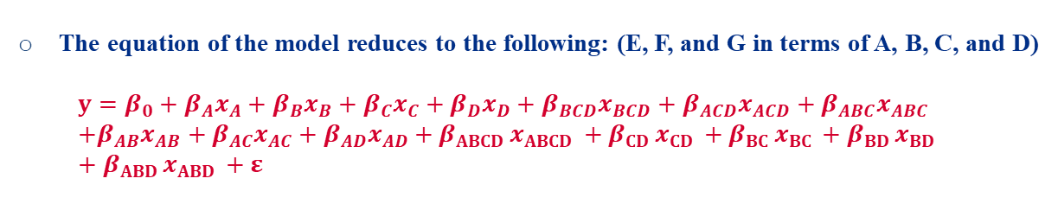
Design II Analysis
Design Description:
It’s an unreplicated 2⁷⁻³ FFD design with 7 factors and 16 runs: (2^{k-p}) with k = 7 and p = 3
The design generators are 3 since p = 3: BCDE = +I, ACDF = +I, ABCG = +I.
Resolution IV: (Maximum Resolution)
The defining relations are 7 since 2^{p} – 1 = 7.
The alias structure consists of 15 relations since 2^{k-p} – 1 = 15.
The equation of the model reduces to the following: (E, F, and G in terms of A, B, C, and D) $y=β_{0}+{β_{A}x}_{A}+{β_{B}x}_{B}+{β_{C}x}_{C}+{β_{D}x}_{D}+{β_{BCD}x}_{BCD}+{β_{ACD}x}_{ACD}+{β_{ABC}x}_{ABC}$ $+{β_{AB}x}_{AB}+{β_{AC}x}_{AC}+{β_{AD}x}_{AD}+{β_{ABCD }x}_{ABCD }+{β_{CD }x}_{CD }+{β_{BC }x}_{BC }+{β_{BD }x}_{BD }+{β_{ABD }x}_{ABD }+ε$
Degree of freedom of the error: ${df}_{Error}=0$(Where: ${df}_{Factor/Interaction}=1$)

Slide 11
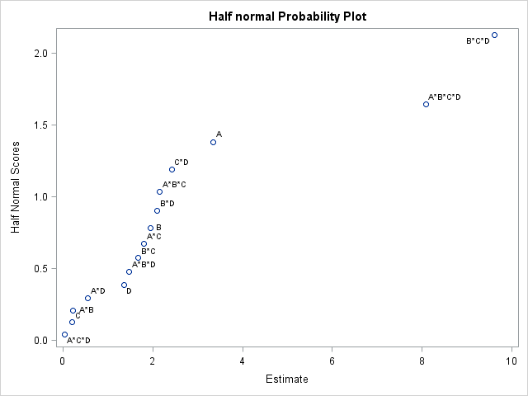
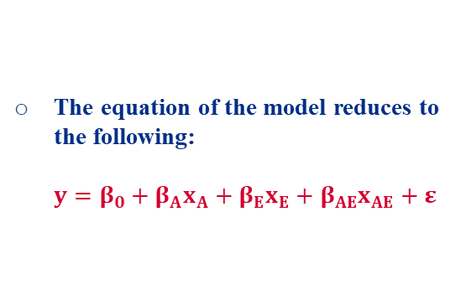

Design II Analysis
Model Analysis:
Half Normal Plot: A, ABCD, and BCD should be significant
The equation of the model reduces to the following: $y=β_{0}+{β_{A}x}_{A}+{β_{E}x}_{E}+{β_{AE}x}_{AE}+ε$
${df}_{Error}=12$
Note: E = BCD, Thus AE = ABCD

Slide 12
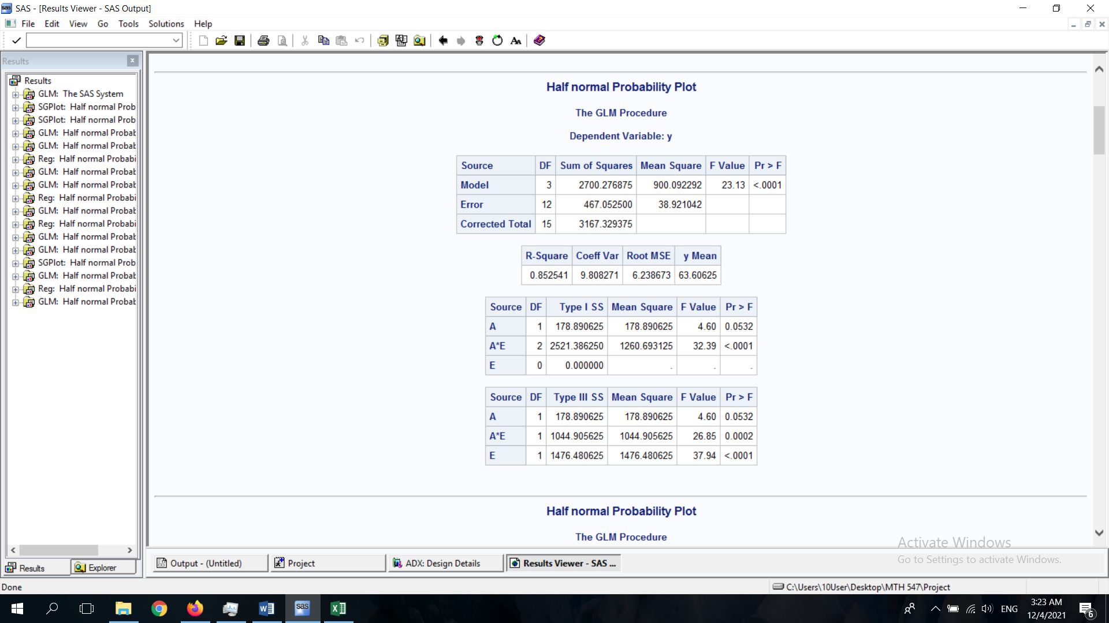


Design II Analysis
Model Analysis:
Testing If The Model Is Fit: Fit ✓
${R_{adj}}^{2}=0.8157$
Testing The Significance of The Parameters: All significant.

Slide 13
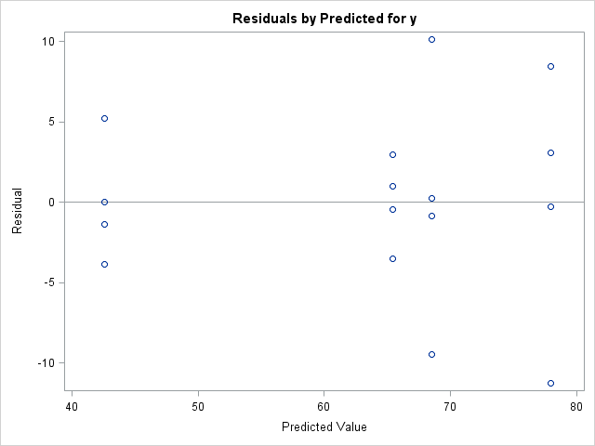
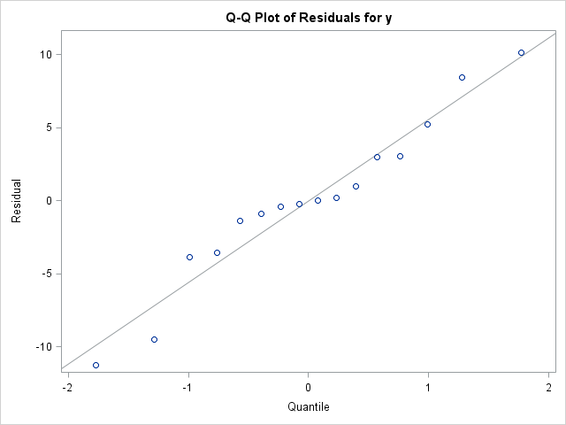
Design II Analysis
Adequacy Plots 1: (No Transformation Needed)
The Residuals Have Equal Variances
The Residuals seem to be Normally Distributed

Slide 14
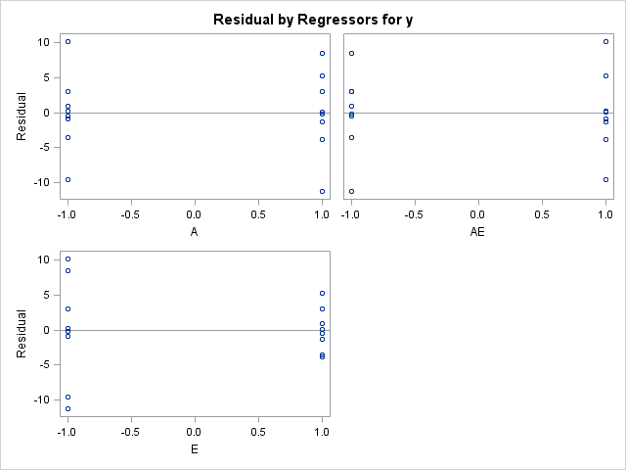
Design II Analysis
Adequacy Plots 2: (Equal Variances Amongst The Settings)

Slide 15
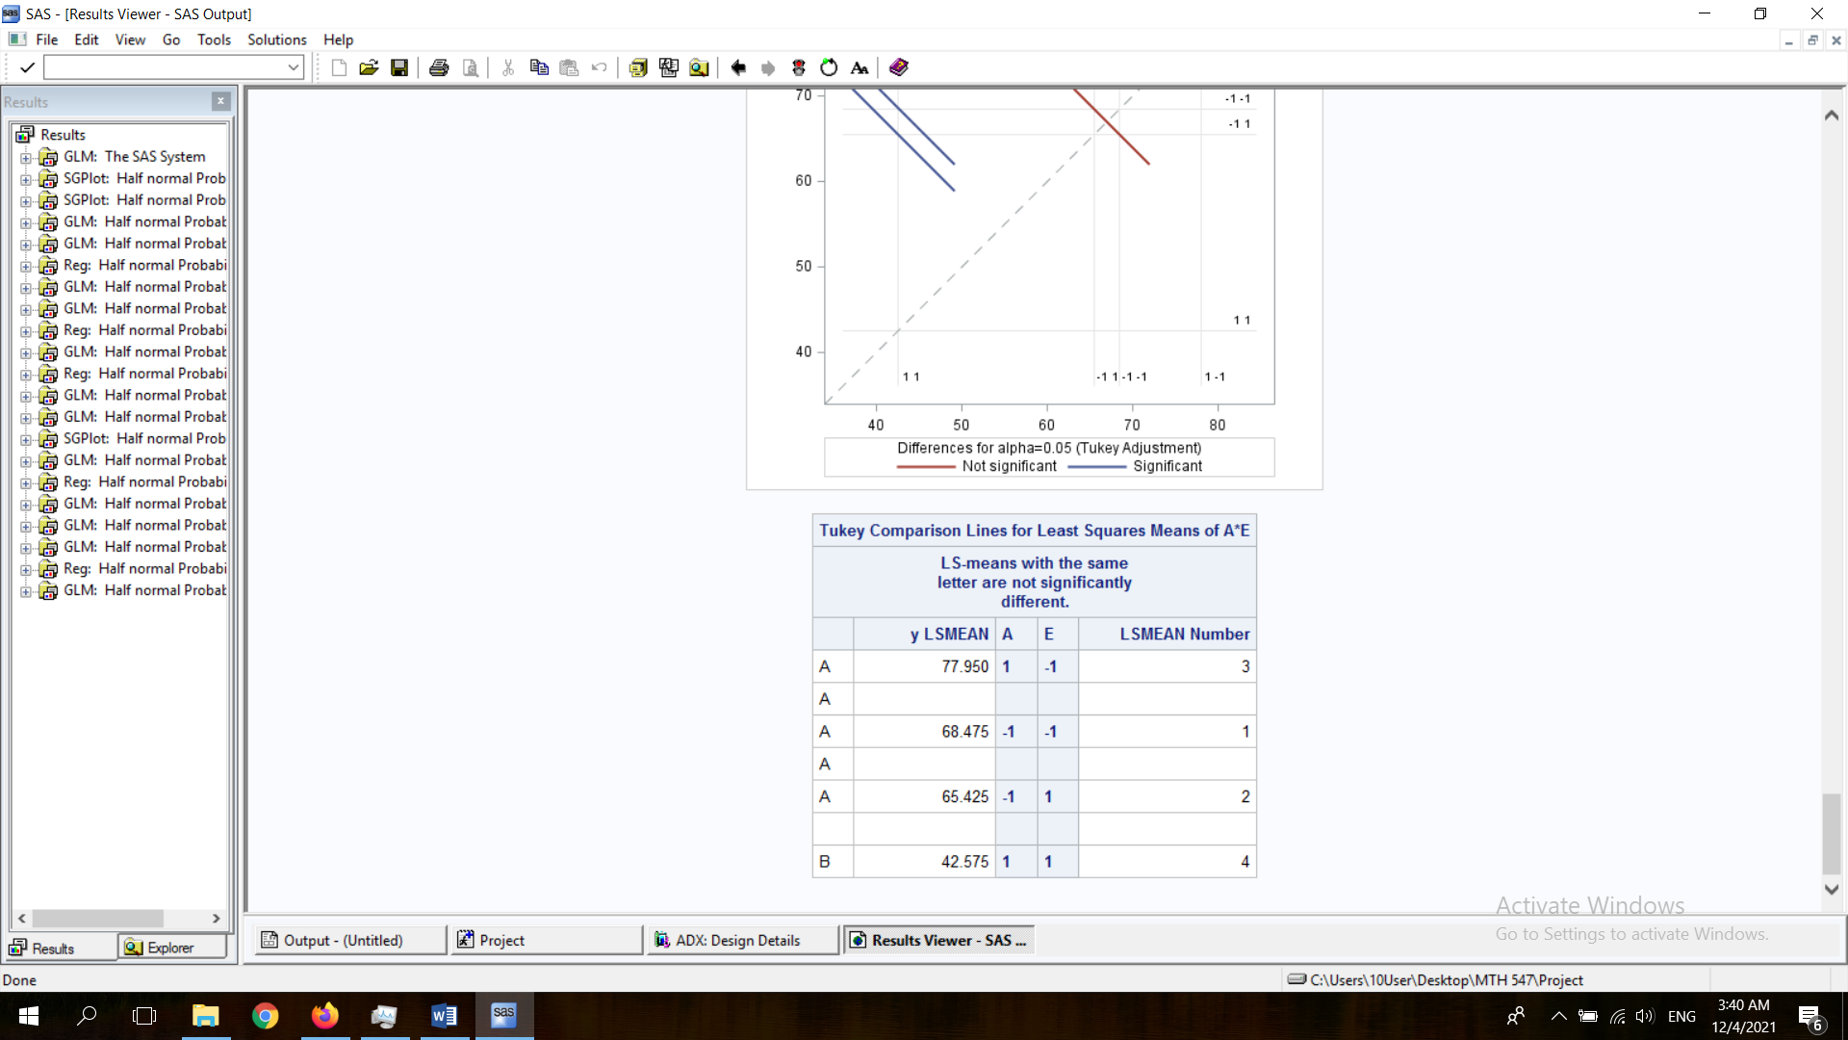
Design II Analysis
Best Setting(s): (Minimum Time)
A = 1 & E = 1 for an average of 42.575 minutes
Or: Water Supply Source: Well & Caustic Soda Addition Rate: High
Note: The p-values assure that this is true.

Slide 16
Conclusion
Designs Comparison:
The active factors differ between the same experiment of different runs.
However, factors A and E are active in both designs.
The best setting remained the same in both designs: Design I: A = 1 & C = 1, but AC = E => best setting A = 1 & E = 1. Design II: A = 1 & E = 1.
Thus, we can conclude that still running the experiment few runs is still sometime somewhat accurate and reliable.
What are the chances to get exactly at least the main factors to be significant in an experiment with less runs than the same experiment with more runs?
Questions?

Slide 17
References
Data Sets:
Program: SAS and Excel
https://www.itl.nist.gov/div898/software/dataplot/datasets.htm

Slide 18
THANK YOU!

